Slide 1
Local Search

Slide 2
Outline
Hill Climbing
Genetic Algorithm
Simulated annealing
Summary

Slide 3
Outline
Hill Climbing
Genetic Algorithm
Simulated annealing
Summary

Slide 4
Hill Climbing
hillClimbing(startNode){
x ← startNode
while (halt condition is not satisfied ) {
Generate solution x’ based on x
Evaluate the f (x’)
If f(x’)>f(x) {
x = x’
}
}
}

Slide 5
Hill-climbing algorithm
Hill-climbing algorithm use the idea of greedy algorithm:
Each time it selects the best node in the neighborhood of current node to compare
If the best neighbor is better than the current point, it will move to the neighbor. Otherwise, the process will be ended, and it returns the current point.
So, it has all the advantages and disadvantages of greedy algorithms:
Advantages: Simple and easy to implement
Disadvantages: depends on the initial point, in most cases, can only find a local optimal solution, can not get the global optimal solution.

Slide 6
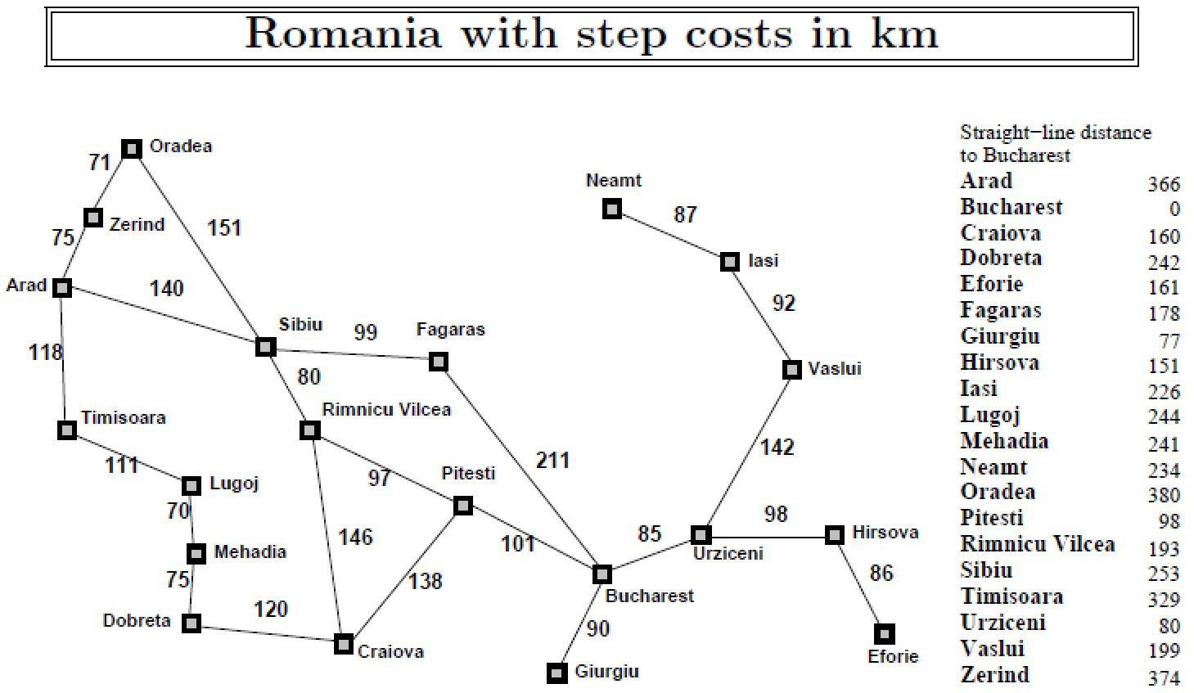
Hill-climbing for route search
Start: Arad
Target: Bucharest
How to evaluating which neighborhood is best?
For simplicity, the straight-line distance to the target city is used to evaluate neighbor nodes
start
f(x) = straight-line distance to Bucharest
How to generate x’ based on x?
target
Randomly select the adjacency node of x

Slide 7
One possible execution process of a hill climbing algorithm for route search

Slide 8
Hill-climbing algorithm: construction of neighbors
Neighbor construction for eight-queen problem:
If the initial position is [5, 3, 0, 5, 7, 1, 6, 0], the neighbor can be constructed as the positions differing from the current position by a value on a single bit
1、[5,3,0,5,7,1,6,0]---→[0,3,0,5,7,1,6,0], [1,3,0,5,7,1,6,0]
[2,3,0,5,7,1,6,0], [3,3,0,5,7,1,6,0]
[4,3,0,5,7,1,6,0], [6,3,0,5,7,1,6,0]
[7,3,0,5,7,1,6,0]
2、[5,3,0,5,7,1,6,0]---→[5,0,0,5,7,1,6,0], [5,1,0,5,7,1,6,0]
[5,2,0,5,7,1,6,0], [5,4,0,5,7,1,6,0]
[5,5,0,5,7,1,6,0], [5,6,0,5,7,1,6,0]
[5,7,0,5,7,1,6,0]
And so on.

Slide 9
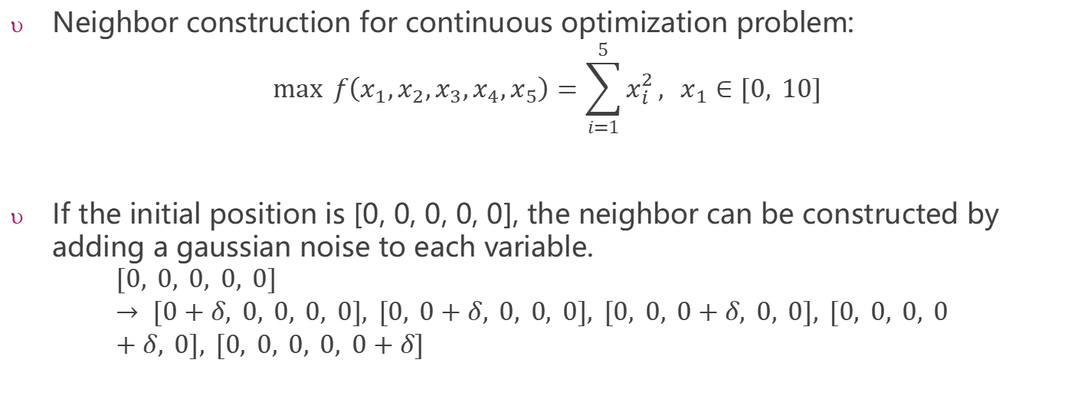
Hill-climbing algorithm: continuous optimization problem
Neighbor construction for continuous optimization problem:
$$\max{f\left(x_{1},x_{2},x_{3},x_{4},x_{5}\right)}=\sum_{i=1}^{5}{x_{i}^{2}}, x_{1}∈[0, 10]$$
If the initial position is [0, 0, 0, 0, 0], the neighbor can be constructed by adding a gaussian noise to each variable.
$$[0, 0, 0, 0, 0] → [0+δ, 0, 0, 0, 0], [0, 0+δ, 0, 0, 0], [0, 0, 0+δ, 0, 0], [0, 0, 0, 0+δ, 0], [0, 0, 0, 0, 0+δ]$$

Slide 10
Outline
Hill Climbing
Genetic Algorithm
Simulated annealing
Summary

Slide 11
Genetic Algorithm
传入初始化种群
Initial population
选择
Selection process
交叉
crossover
变异
mutation
新种群产生完毕
Already generate a new population

Slide 12
Parameters of Genetic Algorithm
population: Initial population
fitness_fn: fitness evaluation function
gene_pool: the value range of single gene, default to be {0, 1}
f_thres: threshold value for fitness value. Algorithm will terminate if we find a solution with fitness value larger than f_thres. If set to 0, then algorithm will terminate after ngen iterations
ngen: number of generations
pmut: probability of permutation

Slide 13
Overall Flowchart of Genetic Algorithm
Flowchart:
1. Evaluate the fitness of individuals corresponding to each chromosome (fitness function: fitness_fn)
2. According to the principle that individuals with higher fitness gain greater probability of selection, two individuals are selected from the population as the father and mother (weighted random algorithm)
3. Extract chromosomes of both parents and crossover them to produce offspring
4. Perform mutation to the chromosomes of offsprings (not every cycle, follow the mutation probability: pmut; the mutation needs to know the range of genes: gene pool)
5. Repeat steps 2, 3, and 4 until a new population is produced
If a satisfactory solution is found (fitness threshold: f_thres) or the upper limit of the number of iterations (ngen) is reached, then terminates the algorithm, otherwise returns to 1.

Slide 14
Key Components of Genetic Algorithm
Initialize population
Fitness function
Generating offspring
selection
crossover
mutation

Slide 15
Initialize Population
Consider Eight Queen for example, we can initialize population by:
population = init_population(5, range(8), 8)

Slide 16
Fitness Function
This should be designed case by case
If we consider Eight Queens, the fitness function can be defined as follows:
 |  |  | Q
 |  |  |  |  |  | Q
Q
 |  |  | Q
 |  |  |  |  |  |  | Q
 |  |  | Q
 |  |  |  |  |  |  | Q
 |  |  |  |  |  |  | Q
[3, 6, 0, 3, 7, 3, 7, 7] 19
Optimal solution: the situation in which the eight queens do not attack each other gets the fitness value 28 (Every time we consider comparison with later rows, i.e., 7 + 6 + 5 + . . . + 1 = 28)

Slide 17
Eight Queen: Initialize Population
Population Fitness
[3, 6, 0, 3, 7, 3, 7, 7] ------------------ 19
[0, 2, 6, 0, 7, 3, 5, 2] ------------------ 23
[4, 3, 3, 5, 0, 6, 4, 5] ------------------ 19
[7, 7, 0, 7, 3, 7, 0, 2] ------------------ 20
[7, 0, 2, 2, 7, 7, 6, 5] ------------------ 19

Slide 18
Selection
Interesting choice: weighted random algorithm, individuals with high adaptivity are more likely to be selected

Slide 19
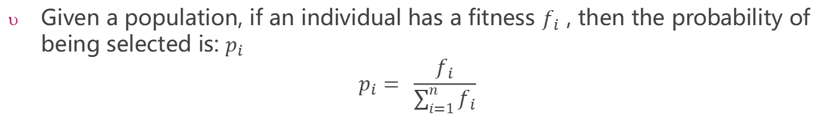
Eight Queen : Selection
Given a population, if an individual has a fitness $f_{i}$ , then the probability of being selected is: $p_{i}$
$$p_{i}= \frac{f_{i}}{\sum_{i=1}^{n}{f_{i}}}$$
[3, 6, 0, 3, 7, 3, 7, 7] ------------------ 19 -------→ 19%
[0, 2, 6, 0, 7, 3, 5, 2] ------------------ 23 -------→ 23%
[4, 3, 3, 5, 0, 6, 4, 5] ------------------ 19 -------→ 19%
[7, 7, 0, 7, 3, 7, 0, 2] ------------------ 20 -------→ 20%
[7, 0, 2, 2, 7, 7, 6, 5] ------------------ 19 -------→ 19%
sum = 100

Slide 20
Eight Queen: Crossover and Mutation
[3, 6, 0, 3, 7, 3, 7, 7] ------------------ 19 -------→ 19%
[0, 2, 6, 0, 7, 3, 5, 2] ------------------ 23 -------→ 23%
[4, 3, 3, 5, 0, 6, 4, 5] ------------------ 19 -------→ 19%
[7, 7, 0, 7, 3, 7, 0, 2] ------------------ 20 -------→ 20%
[7, 0, 2, 2, 7, 7, 6, 5] ------------------ 19 -------→ 19%
If the random variable indicating crossover is c = 5, then the new individual is ?
If the random variable indicating mutation is c = 3 and the value after mutation is 7, then the new individual is ?

Slide 21
Eight Queen Example: Crossover and Mutation
[3, 6, 0, 3, 7, 3, 7, 7] ------------------ 19 -------→ 19%
[0, 2, 6, 0, 7, 3, 5, 2] ------------------ 23 -------→ 23%
[4, 3, 3, 5, 0, 6, 4, 5] ------------------ 19 -------→ 19%
[7, 7, 0, 7, 3, 7, 0, 2] ------------------ 20 -------→ 20%
[7, 0, 2, 2, 7, 7, 6, 5] ------------------ 19 -------→ 19%
If the random variable indicating crossover is c = 5, then the new individual is :
[0,2,6,0,7,7,6,5]
If the random variable indicating mutation is c = 3 and the value after mutation is 7, then the new individual is :
[0,2,6,7,7,7,6,5]

Slide 22
Simple GA Not Suitable for Eight Queen
Simple GA often fails to find a valid solution to the Eight Queens problem.
Why?
Improvement

Slide 23
Genetic Algorithm Note
Evolutionary algorithms (EAs) are a family of population-based search algorithms
What we introduced is just a simple EA: genetic algorithm
Other EAs: evolutionary strategy, evolutionary programming, genetic programming as well as their variants.
Different EAs vary in different search operators (i.e. mutation, crossover and selection)

Slide 24
Application of GA for Finding Maximum of Functions
Beginning

Slide 25
Application of GA for Finding Maximum of Functions
Midterm

Slide 26
Application of GA for Finding Maximum of Functions
End

Slide 27
Not Always Get Optimal Solution
Another run: Beginning

Slide 28
Not Always Get Optimal Solution
Another run: midterm

Slide 29
Not Always Get Optimal Solution
Another run: end
For this run, we observe a premature convergence.
Premature convergence occurs when the population has become more difficult to produce offspring better than the parents through crossover and mutation of chromosomes.
Standard crossover simply repeats the current parent.
Further optimization will be completely dependent on the mutation which may be very slow.
indicates the randomness of EA

Slide 30
Outline
Hill Climbing
Genetic Algorithm
Simulated annealing
Summary

Slide 31
Simulated annealing
Simulated annealing is a probabilistic method proposed in Kirkpatrick, Gelett and Vecchi (1983) and Cerny (1985) for finding the global minimum of a cost function that may possess several local minima. It works by emulating the physical process whereby a solid is slowly cooled so that when eventually its structure is "frozen," this happens at a minimum energy configuration.

Slide 32
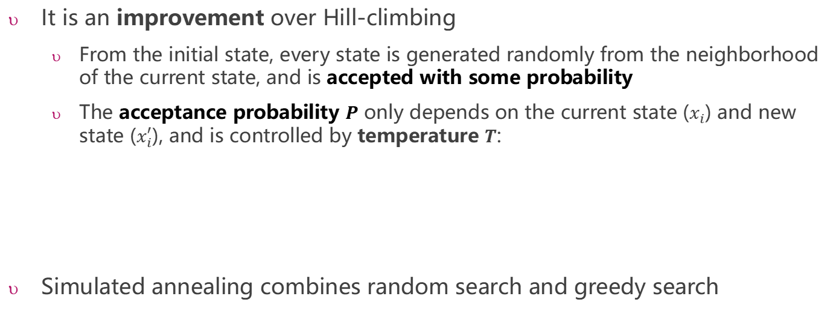
Simulated Annealing
It is an improvement over Hill-climbing
From the initial state, every state is generated randomly from the neighborhood of the current state, and is accepted with some probability
The acceptance probability $P$ only depends on the current state ($x_{i}$) and new state ($x_{i}^{′}$), and is controlled by temperature $T$:
Simulated annealing combines random search and greedy search

Slide 33

Simulated annealing VS Hill Climbing
hillClimbing(startNode){
x ← startNode
while (halt condition is not satisfied ) {
Generate solution x’ based on x
Evaluate the f (x’)
If f(x’)>f(x) {
x = x’
}
}
}
Replace this line with a probability p

Slide 34
Each reduction rule reduces the temperature at a different rate and each method is better at optimizing a different type of model. For the 3rd rule, beta is an arbitrary constant.
//one possible cooling schedule function for simulated annealing
expSchedule(k, lam, limit, t){
if (t < limit){
return k*Math.exp(-lam*t)
}
return 0
}
simulatedAnnealing(startNode, t_{0,} schedule=expSchedule()){
x ← startNode
initial k, lam, limit
t ← t₀
while (halt condition is not satisfied ) {
T = schedule(k, lam, limit, t)
Generate solution x’ based on x
Evaluate the f (x’)
If (f(x’)>f(x)) or (Math.exp((f(x’)-f(x))/T)>random(0.0, 1.0)) {
x = x’
}//end if
update(t)
}//end whhile
}//end simulatedAnnealing
Initial temperature
Cooling schedule function
Metropolis:
At high temperatures, a new state that is much worse than the current state can be accepted; at low temperatures, only a new state that is little bit worse than the current state can be accepted.

Slide 35
Cooling schedule function: parameter controlling annealing process
Increase lam value
Decrease
k value
Decrease limit value

Slide 36
Acceptance criterion and cooling schedule

Slide 37
Practical Issues with simulated annealing
Cost function must be carefully developed, it must be “fractal and smooth”. The energy function of the left would work with SA while the one of the right would fail.

Slide 38
Practical Issues with simulated annealing
The cost function should be fast. It is going to be called “millions” of times.
The best is if we just have to calculate the deltas produced by the modification instead of traversing through all the state.
This is dependent on the application.

Slide 39
Practical Issues with simulated annealing
In asymptotic convergence simulated annealing converges to globally optimal solutions.
In practice, the convergence of the algorithm depends on the cooling schedule.
There are some suggestion about the cooling schedule, but it stills requires a lot of testing and it usually depends on the application.
Start at a temperature where 50%(or higher) of bad moves are accepted.
Each cooling step reduces the temperature by 10%(or smaller).
The number of iterations at each temperature should attempt to move between 1-10 times each “element” of the state.
The final temperature should not accept bad moves; this step is known as the quenching step.

Slide 40
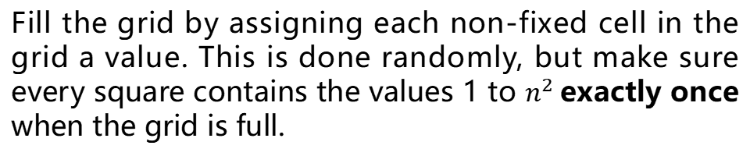
Simulated annealing: Steps for solving Sudoku
1. Generate initial state
Fill the grid by assigning each non-fixed cell in the grid a value. This is done randomly, but make sure every square contains the values 1 to $n^{2}$exactly once when the grid is full.

Slide 41
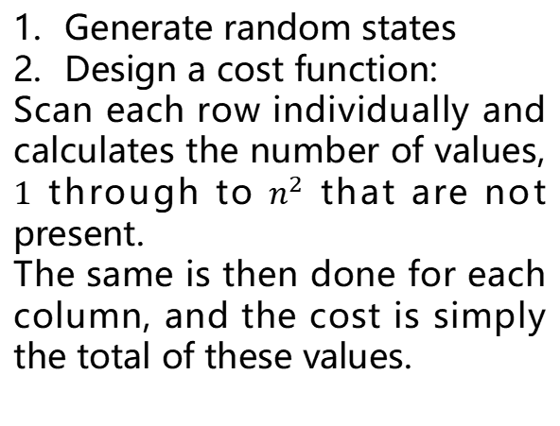
Simulated annealing: Steps for solving Sudoku
Generate random states
Design a cost function:
Scan each row individually and calculates the number of values, $1$ through to $n^{2}$ that are not present.
The same is then done for each column, and the cost is simply the total of these values.

Slide 42
Simulated annealing: Steps for solving Sudoku
Generate random states
Design a cost function
How to generate next states
Determine the initial temperature
Determine the cooling schedule function
You can read the paper below for more detailed information：
https://www.researchgate.net/publication/220403361_Metaheuristics_can_solve_Sudoku_puzzles

Slide 43
Outline
Hill Climbing
Genetic Algorithm
Simulated annealing
Summary

Slide 44
Local Search Overview
Starts from an initial solution and iteratively improves it
Uses neighborhood exploration to find better candidates
Works well for large or complex search spaces

Slide 45
Comparison of Methods
Hill Climbing
Genetic Algorithm (GA)
Simulated Annealing (SA)
Moves to the best neighboring solution
Simple and fast
Easily trapped in local optima
Evolves a population using selection, crossover, and mutation
Explores multiple regions of the search space
Slower and requires parameter tuning
Accepts worse solutions with decreasing probability
Can escape local optima
Sensitive to cooling schedule

